Slide 1


Slide 2

Guided by- Prof. Debendra Maharana
S.N | Name | Registration No
1. | Abdul Naseer | 200101120002
2. | Srija Tripathy | 200101120006
3. | Tangudu Sravani | 200101120010
4. | Shankar Pradhan | 200101120013
5. | Anil Varma | 200101120019
6. 7. 8. | Satish Kumar Vimlesh Kumar Manish Kumar | 200101120020 200101120108 200101120109

Slide 3

Main Page

Slide 4
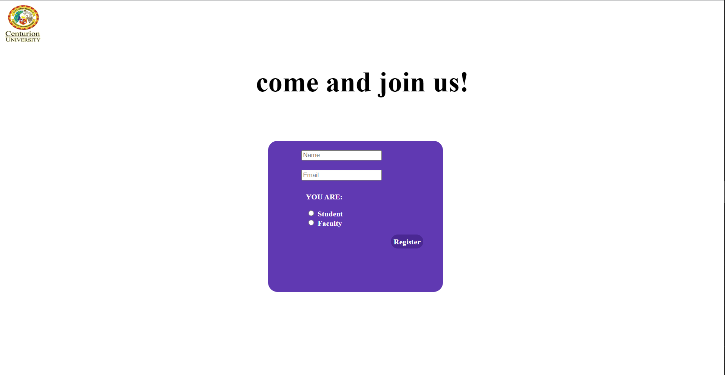
Registration Page

Slide 5
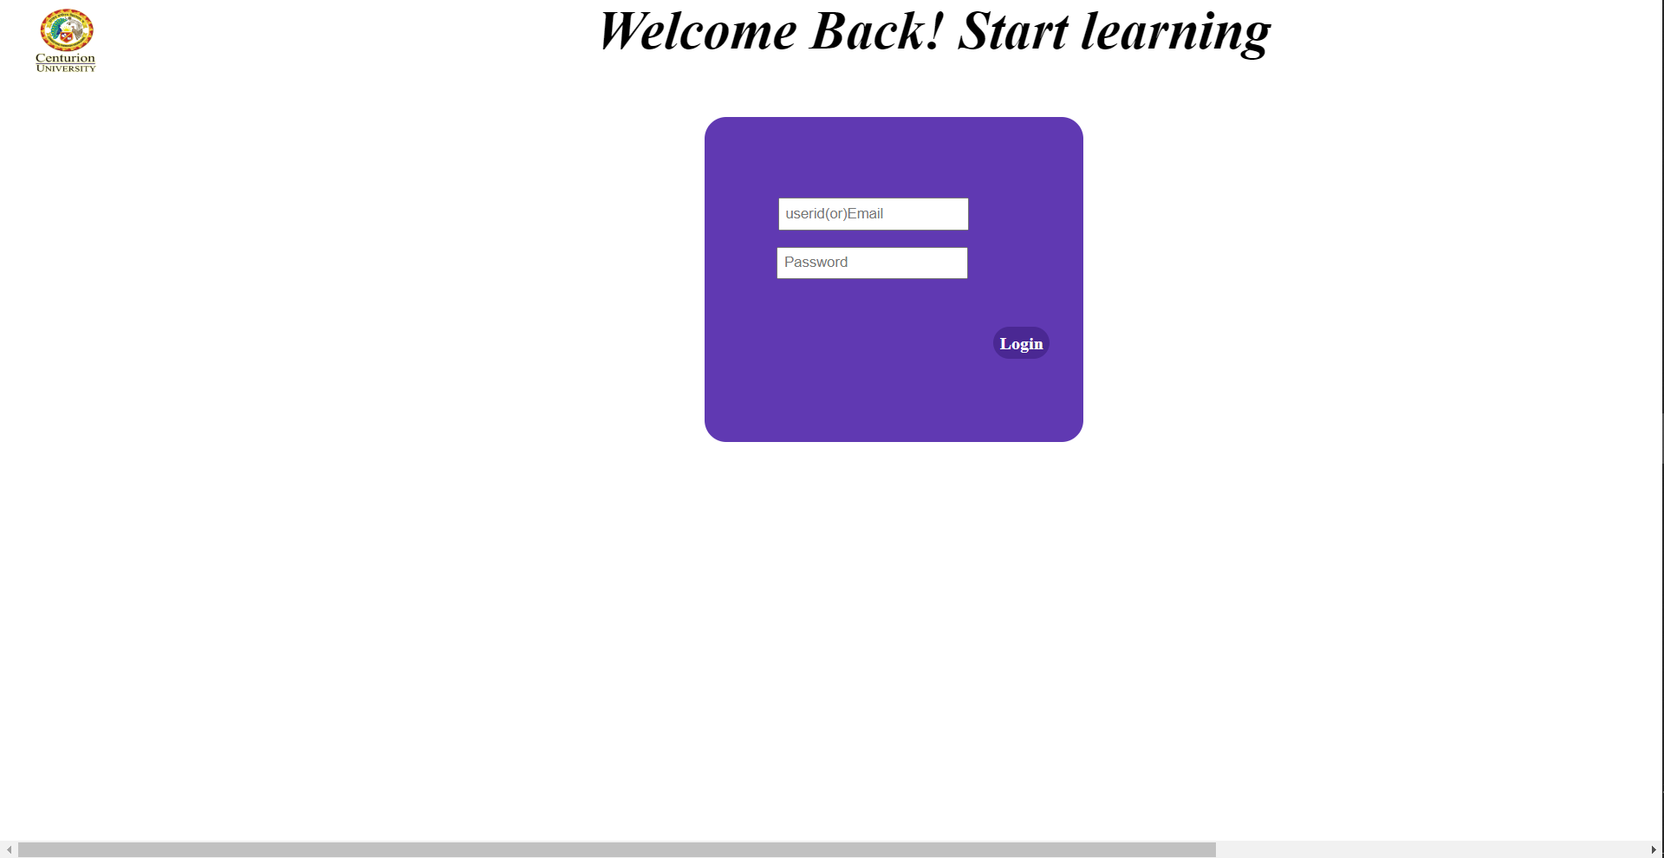
Login Page

Slide 6

Home Page

Slide 7
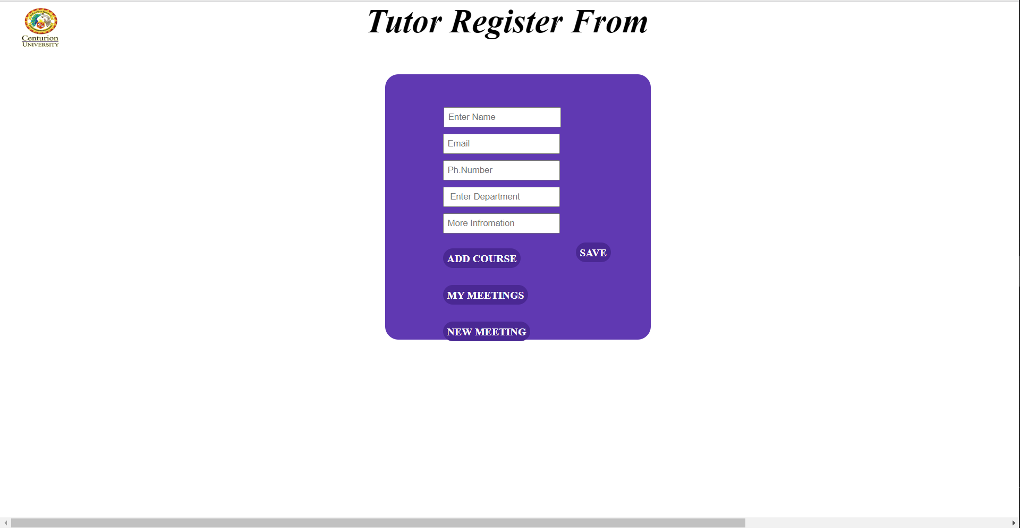
Tutor Profile Page
Tutor Profile

Slide 8
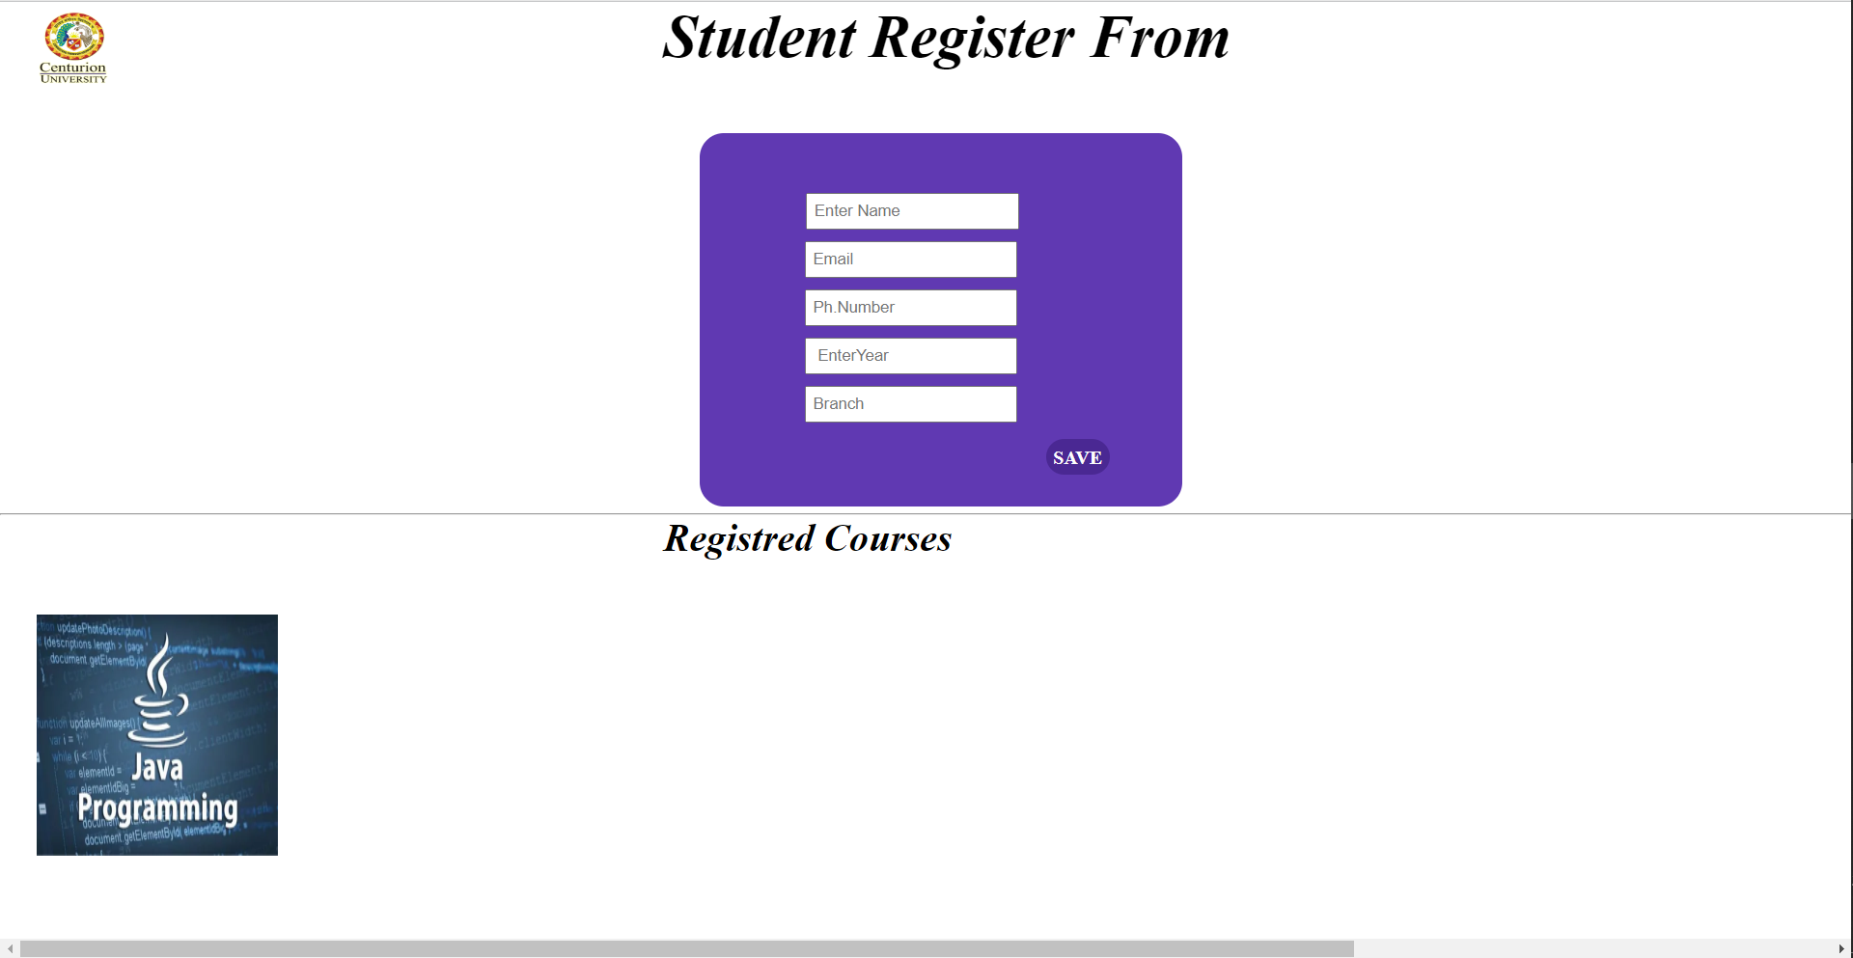
Student Profile Page
Student Profile

Slide 9
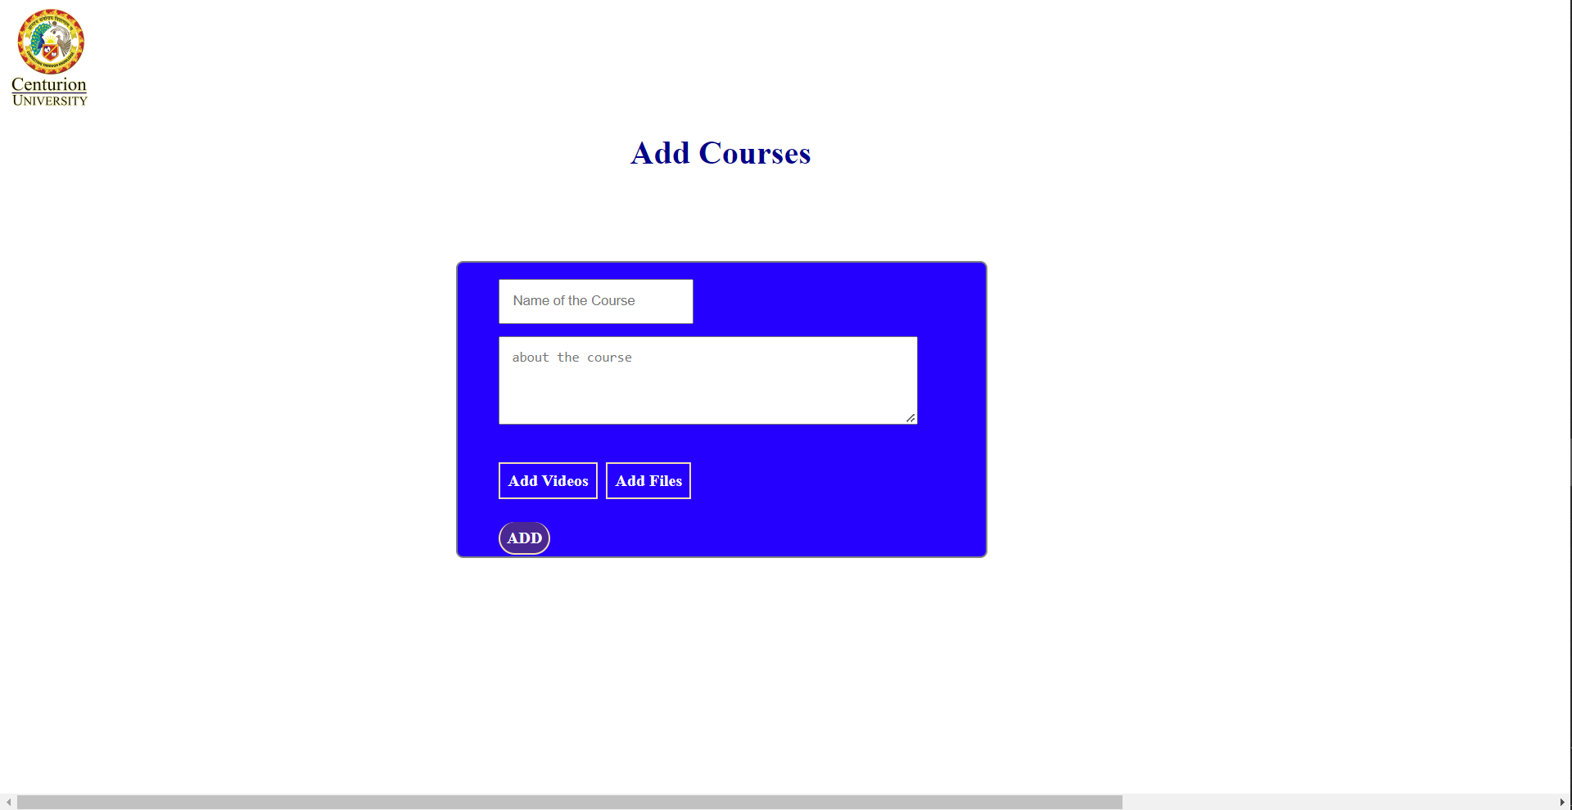
Add Courses Page

Slide 10
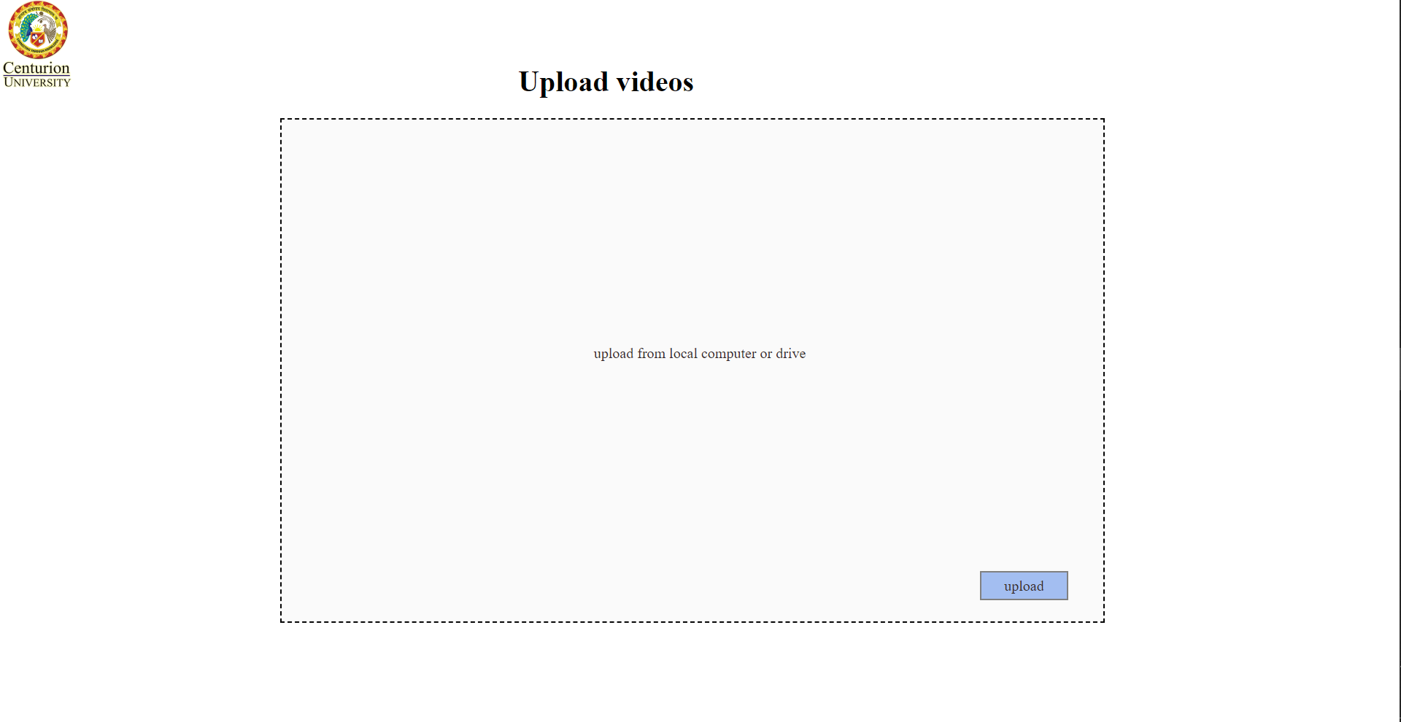
Upload Videos Page

Slide 11
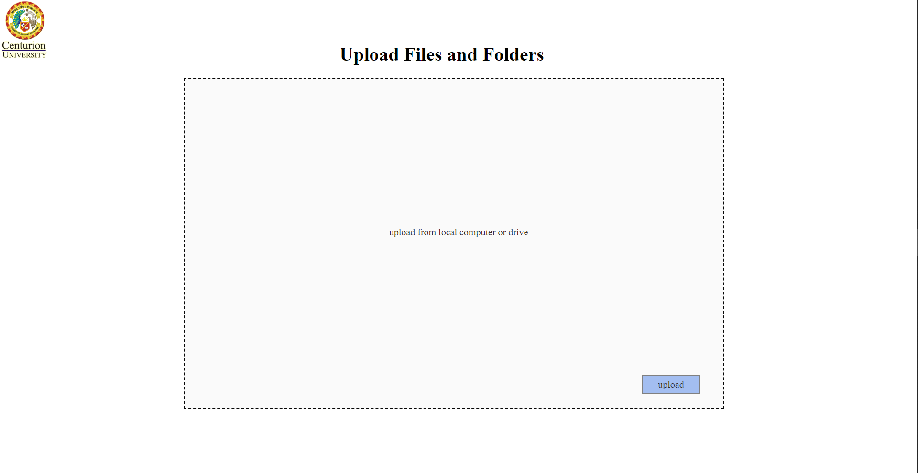
Upload Files and Folders Page

Slide 12
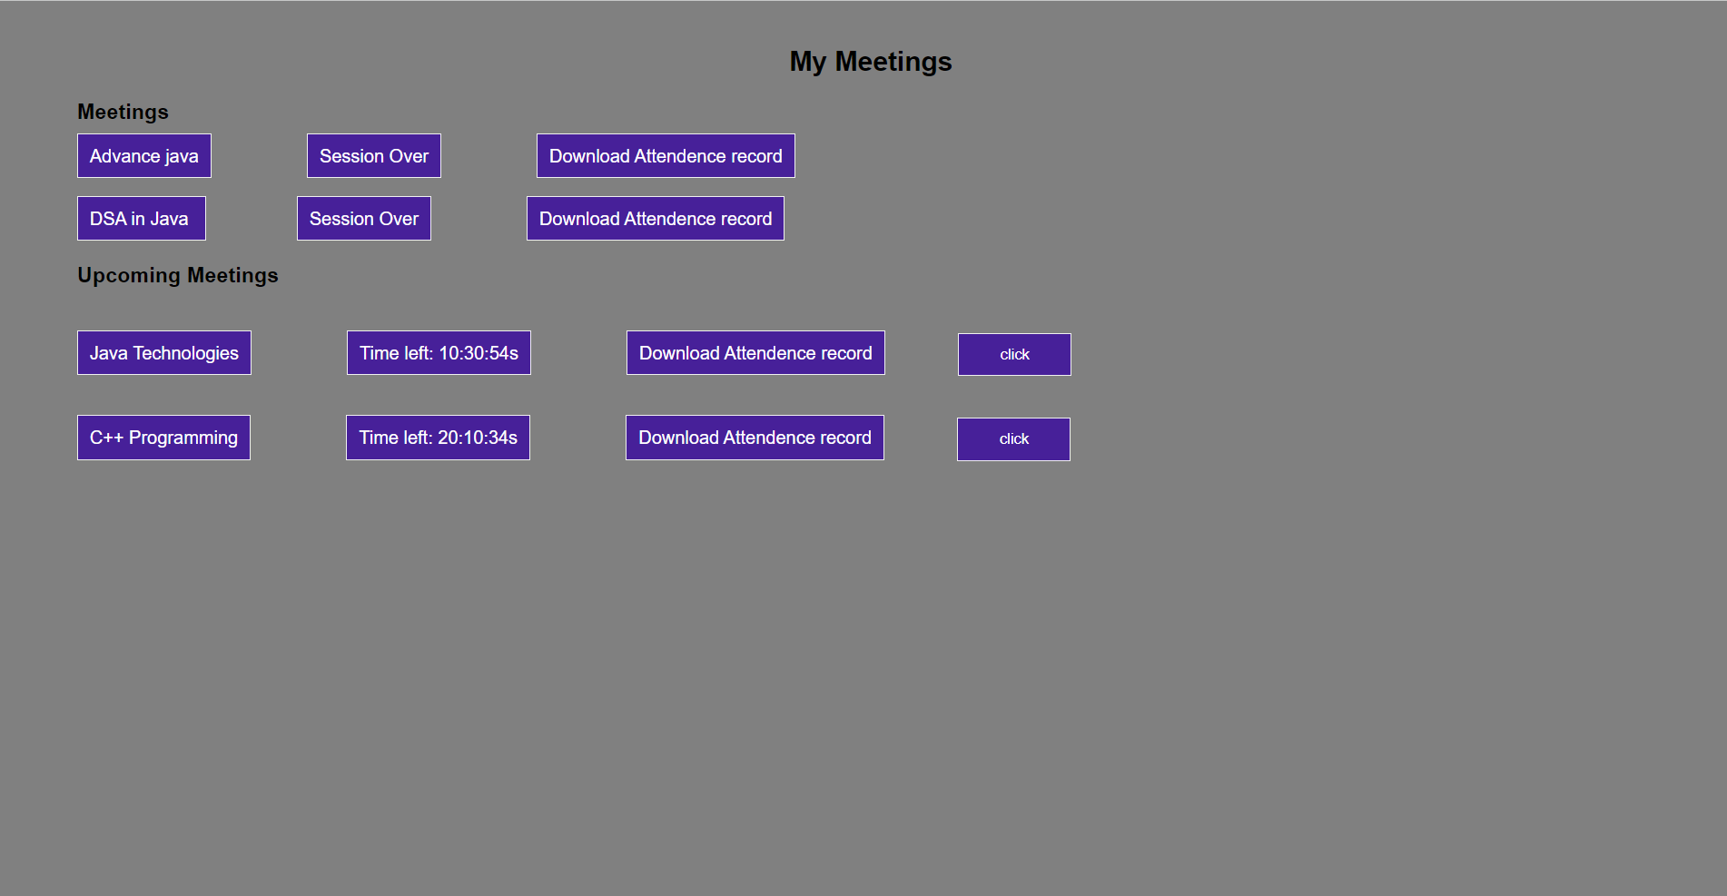
My Meetings Page

Slide 13
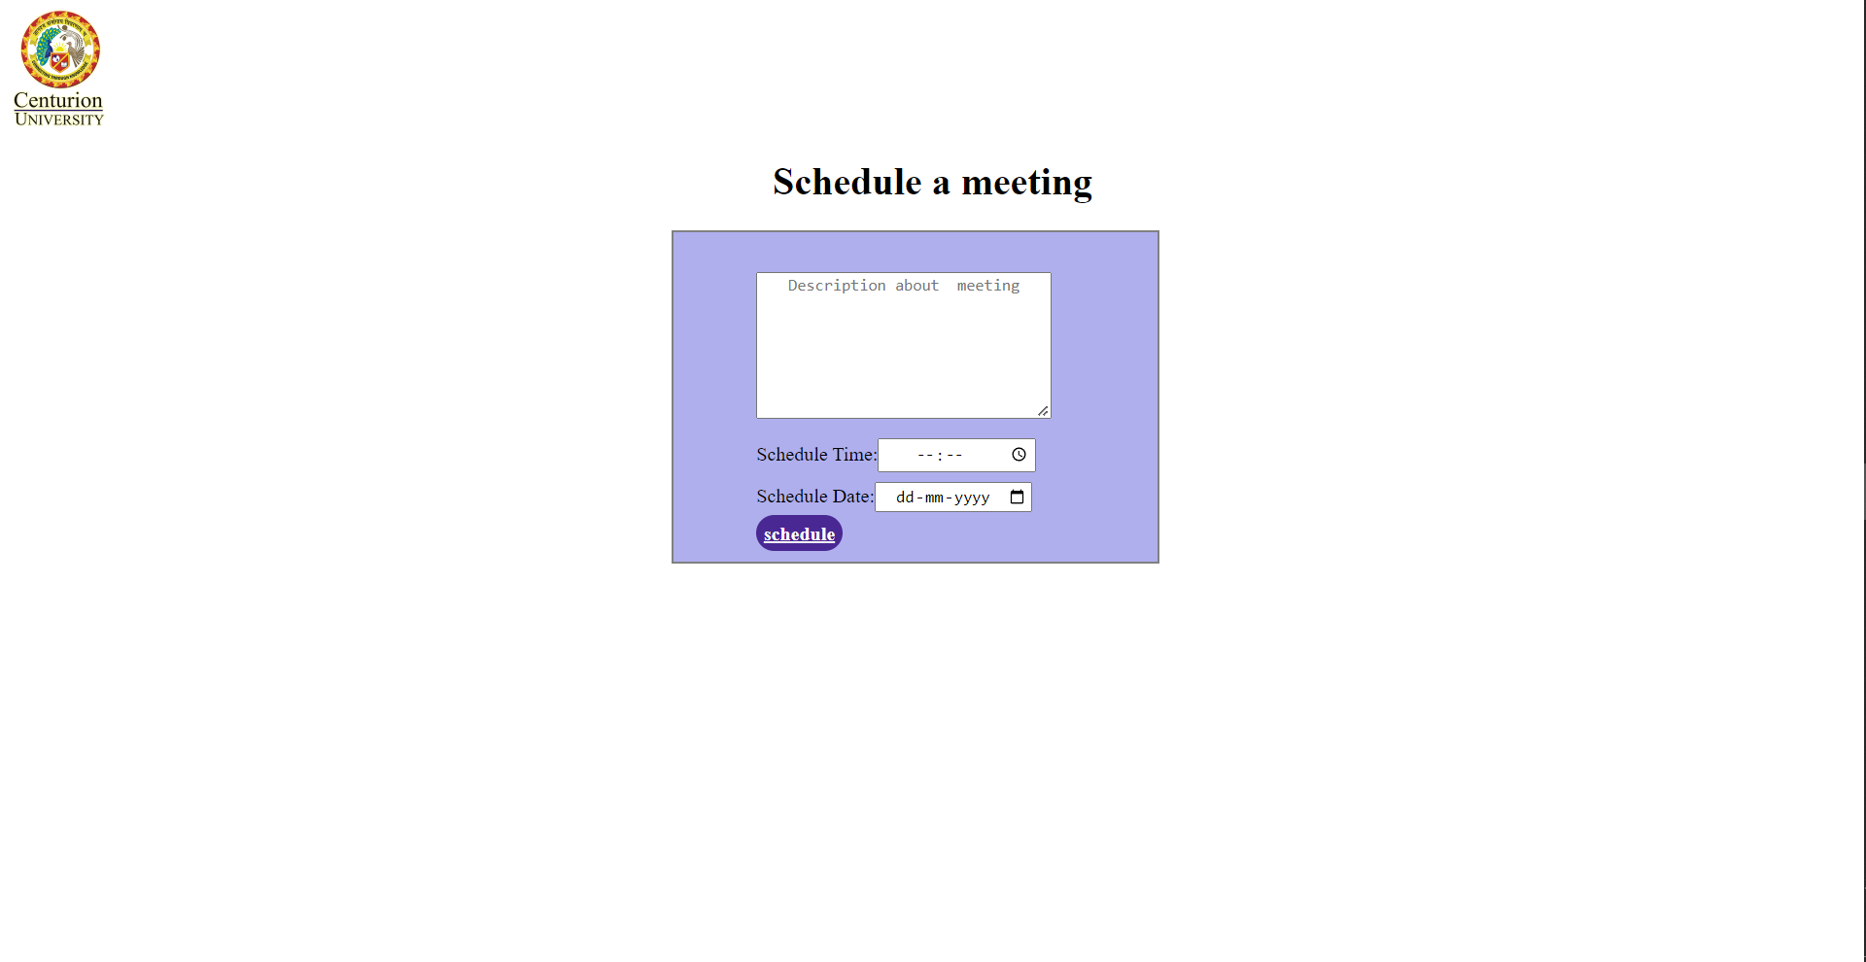
Schedule a Meeting Page

Slide 14
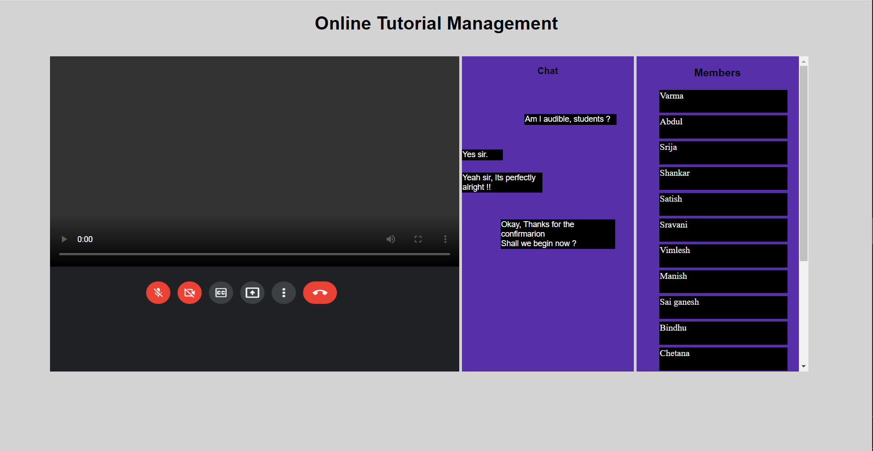
Live Session Page

Slide 15
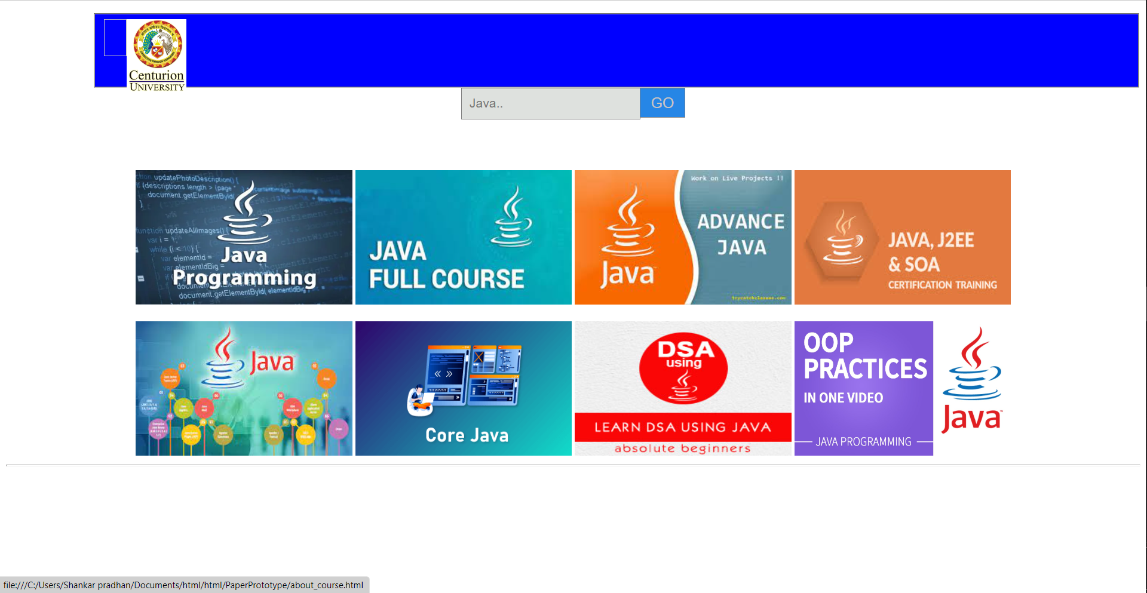
Search Course Page

Slide 16
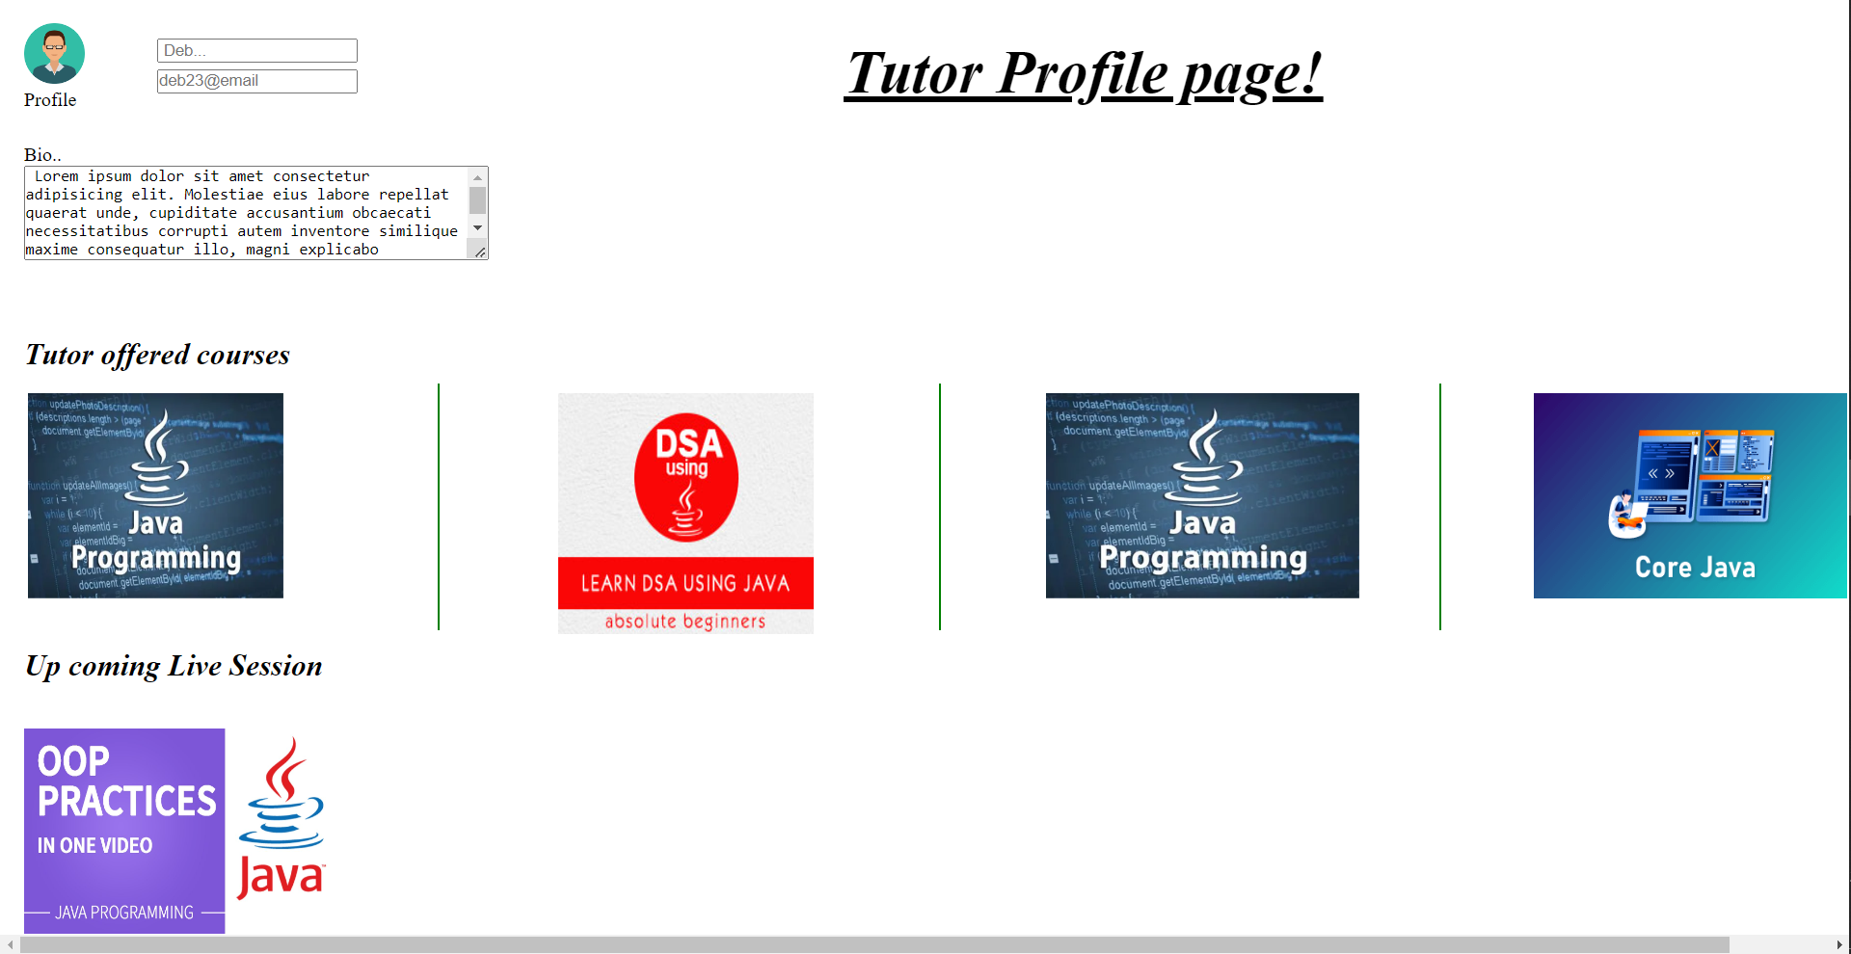
Tutor Profile Page

Slide 17
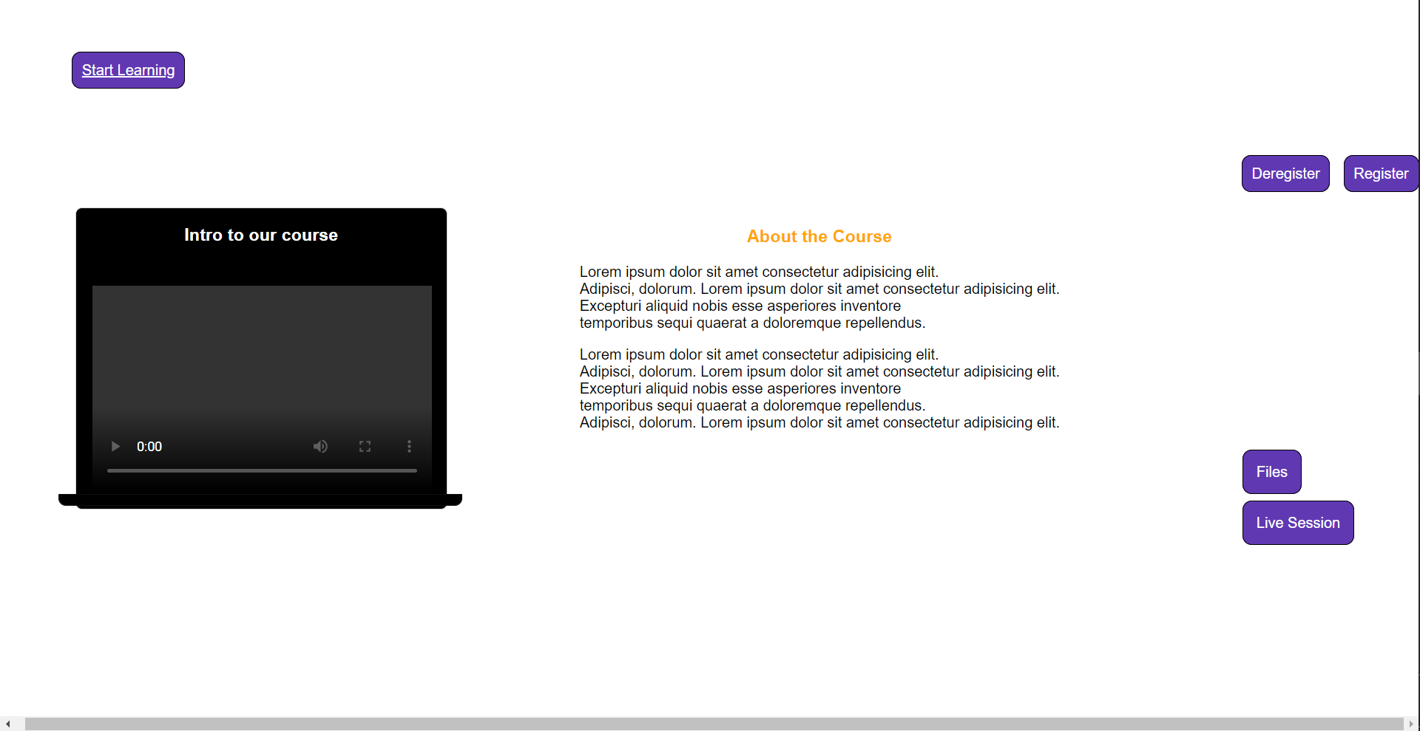
About Course Page

Slide 18
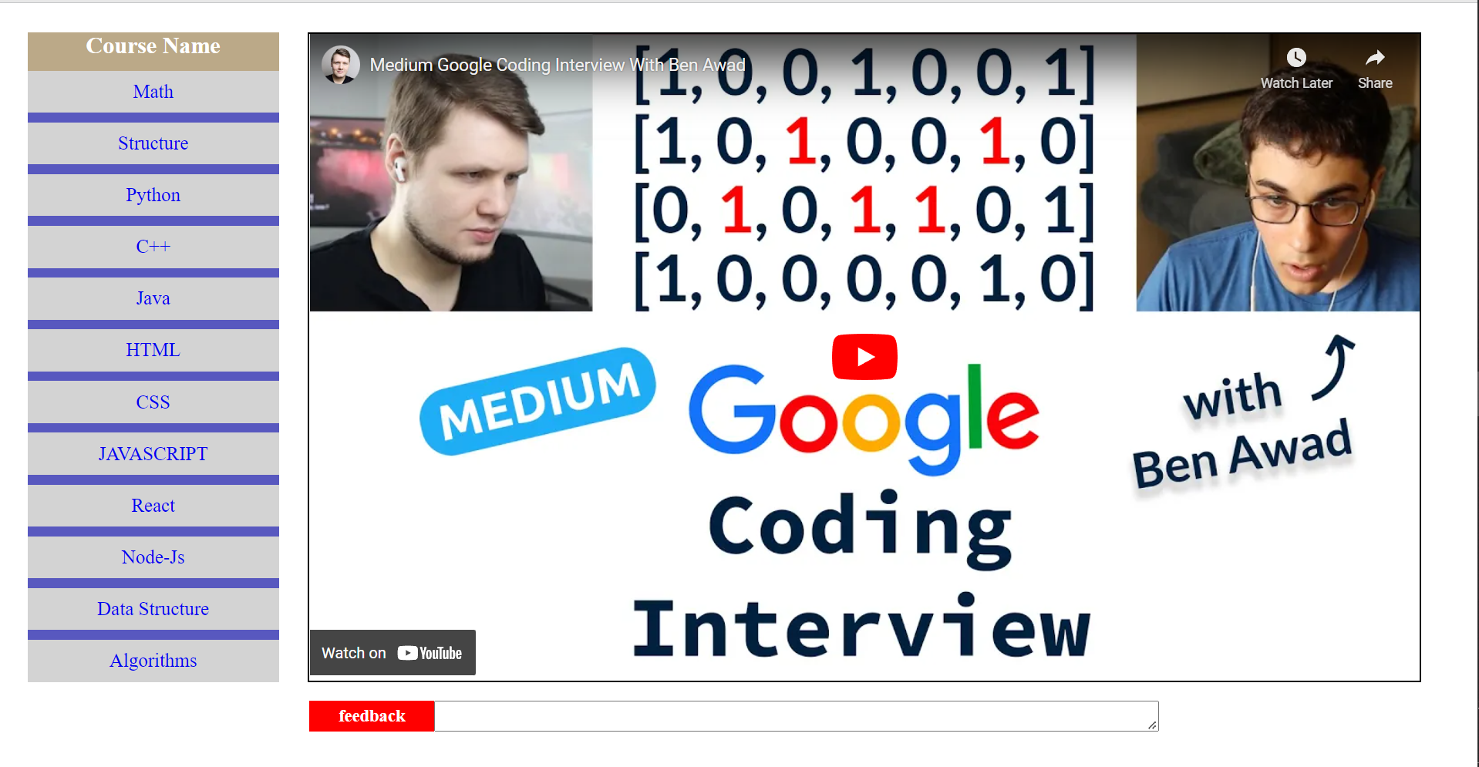
Watch Video Page

